Slide 1


Software Group Project-1
Mentor : Prof. Ritiksha Modi

Slide 2


E-Commerce Website

Slide 3

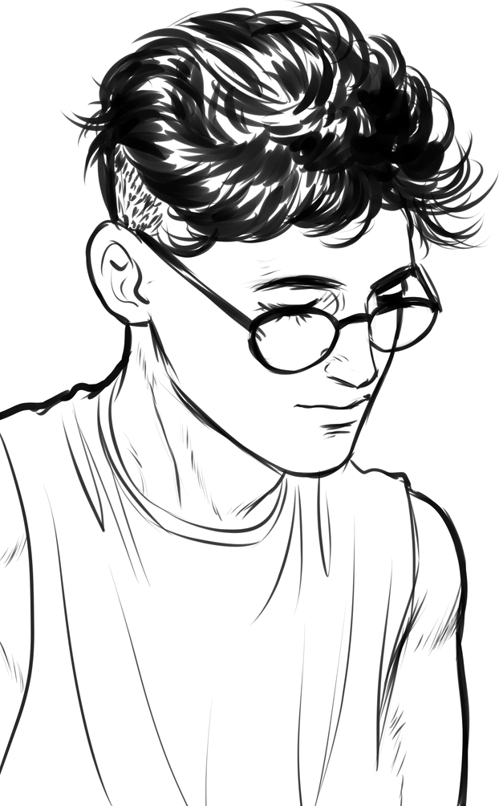
SGP-1
Meet the Group
Bhargav Patel
Devan Patel
Dharm Patel
(20DCS069)
(20DCS070)
(20DCS071)

Slide 4

SGP-1
Introduction
The project is about developing a website for the clothes shop.
The website will showcase all types of fashions wear, for mens , womens ,kids.
The website will be having all the information of the Store along with other features .
The website will of the shop located in Nadiad "D3FashionHub".

Slide 5

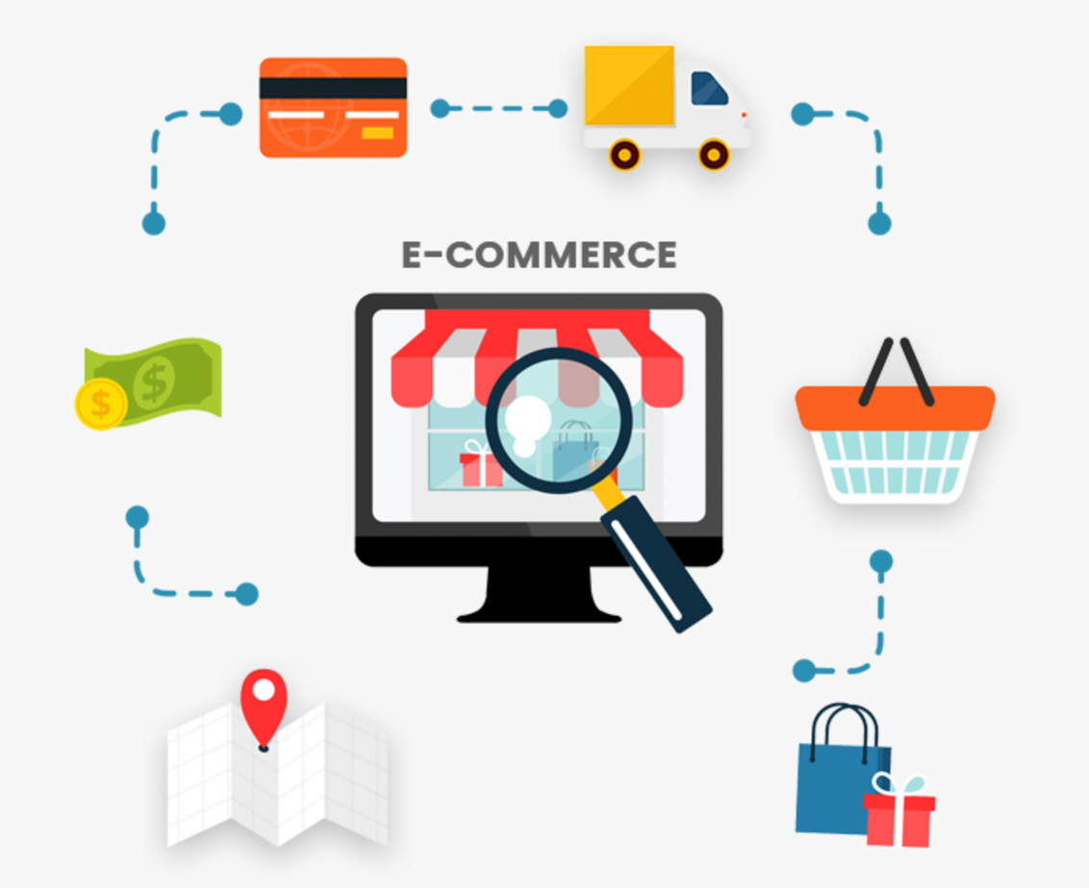
SGP-1
Objectives
The website is designed to give a brief idea about the Shop.
The website will contain all the necessary information about the products and the various brands dealing with.
Website is designed to give glimpse of the firm just by surfing so to get a rough knowledge without physically going to the Shop.
Due to pandemic all around the world, people are becoming more careful so website will help just by surfing it.
As D3FashionHub is a Devan Friend Family business, so this project is to advertise and use it as a customer service.

Slide 6
SGP-1
Problems
Website is a best visual representation of the firm that can be opted to showcase the brands and other features.
Through our website we can pictorically showcase the products to the customers from the comfort of their home.
Website will be having all the customer care number of the brands so customers can directly visit website and register their complaint regarding the product.
Through website, customers can also request for a price and other.. of the certain products and get a reply from the shop without visiting.

Slide 7

SGP-1
Project Scope
The basic motto of this project is to give customers a brief idea about the brands and the products the shop is dealing with.
The purpose of this website is to give the customers the glimpse of our shop and variety of the fashion Wear.
Our website provides all the necessary details needed by the customer and help them selecting the right products from the comfort of their homes

Slide 8

Motivation
The website is designed in a way to cater the required information to the customers without visiting the shop physically.
The flow and structure of the website is sourced from the owner of the firm and from the official websites of the brands they are dealing with.
As due to increase in the number of technology users day by day and due to the pandemic, website will be the best service a firm can give to gain the customer's interest and interact with them virtually.
One of the main reasons to have a website for the business is to increase the organization's credibility.
SGP-1

Slide 9

SGP-1
Technology used
Frontend : HTML,CSS,JS
Backend : PHP,MySQL
Editor : VS Code

Slide 10

SGP-1
Hardware requirement
CPU: for web 1.6 GHz , for web and database 4 x 1.6 GHz CPU.
RAM: 2GB.
Minimum database space: 1GB.
CPU: Quad 2GHz+ CPU.

Slide 11

SGP-1
Software requirement
Operating System : Windows,Mac,Linux
Web Browser : Chrome,Safari,FireFox
Web Server : Netifly,XAMPP
Database : MySQL 5.1 and above

Slide 12
SGP-1
Project
Definition
Clothing website which provide the information of the various fashion products like shoes,watches ,perfumes etc. on the basis of men,women and kids categories.The user can also contact the store owner for their queries and can order the products.
Also sometimes written as "e-commerce" or "eCommerce".

Slide 13
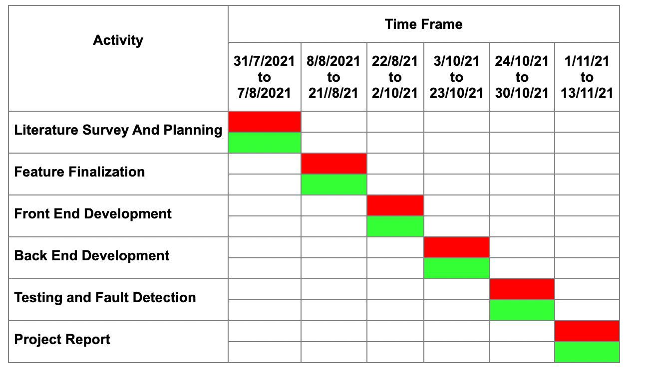
Gantt chart

Slide 14
Project Overview

Slide 15


Home Page
Home
Products
About
Contact
Account
Some Text
Photo
Some Text

Slide 16
Products page
Home
Products
About
Contact
Account
Men
Women
Kids
Products photos

Slide 17
About us page
Home
Products
About
Contact
Account
Banner
Website Details

Slide 18

Contact us page
Home
Products
About
Contact
Account
Banner
Store Details

Slide 19
Now lets see the implementation!!

Slide 20






Flow of implementation
SGP-1
Draw a rough sketch of the homepage...
Start implementing for the homepage
Design for other Webpages
Link other Webpage with the homepage
Give Final edits

Slide 21

SGP-1
Flow of the project
Types
Products
Watches
Footwear
perfume &
Goggles
Clothes
Mens
Womens
Kids

Slide 22
SGP-1
Future Implementation
Admin Panel Dashboard
Shopping Cart
Discount coupon
Ratings

Slide 23
References
01
www.w3school.com
02
www.youtube.com
03
Reference has also been taken from web designing and development tutorials.

Slide 24
Thank
You!
Do you have any questions for us?

